Slide 1
Digital Portfolio
STUDENT NAME :B.Santhosh
REGISTER NO AND NMID : 212403874/ D0D7D6443F981DBAEEE44A59F3C1D500
DEPARTMENT : Computer Application
COLLEGE/UNIVERSITY : Tagore College Of Art & Science Chrompet, Chennai Madras University

Slide 2
PROJECT TITLE
PERSONAL PORTFOLIO

Slide 3


AGENDA
Problem Statement
Project Overview
End Users
Tools and Technologies
Portfolio design and Layout
Features and Functionality
Results and Screenshots
Conclusion
Github Link
3/21/2024 Annual Review

Slide 4

PROBLE STATEMENT
Many students and professionals struggle to present their skills, achievements, and projects in a structured and accessible format. A personal portfolio solves this by providing a centralized platform to display one’s work effectively.

Slide 5
POTFOLIO DESIGN AND LAYOUT
Clean and professional interface
Sections: Home, About, Skills, Projects, Certificates, Contact
Easy navigation with responsive design
5

Slide 6

PROJEC OVERVIEW
This project is a responsive portfolio website built to highlight educational details, skills, certifications, and projects. It serves as a digital resume and an interactive way to showcase personal growth.

Slide 7

WHO ARE THE END USERS?
Students creating digital resumes
Job seekers showcasing skills to recruiters
Developers & designers displaying projects
Employers/recruiters evaluating candidates

Slide 8
TOOLS AND TECHNIQUES
HTML5, CSS3, JavaScript – for structure, design, and interactivity
Bootstrap – for responsive layout
GitHub Pages – for hosting

Slide 9
FEATURES AND FUNCTIONALITY
Responsive across devices
Interactive navigation bar
Skills representation with progress indicators
Contact section for communication
Project and certificate showcase

Slide 10
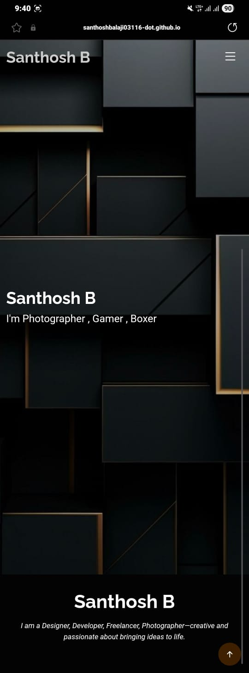
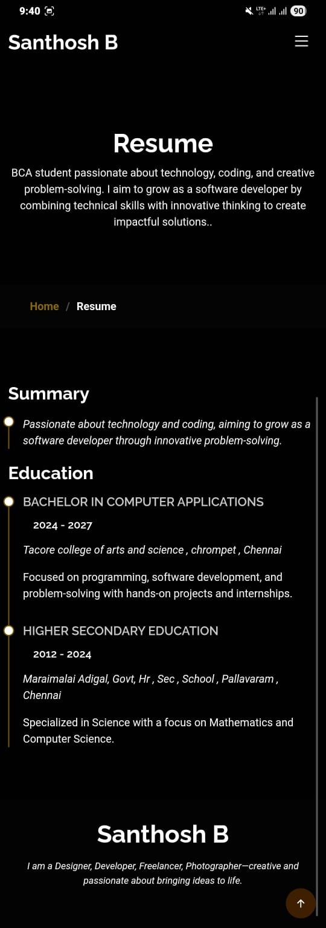
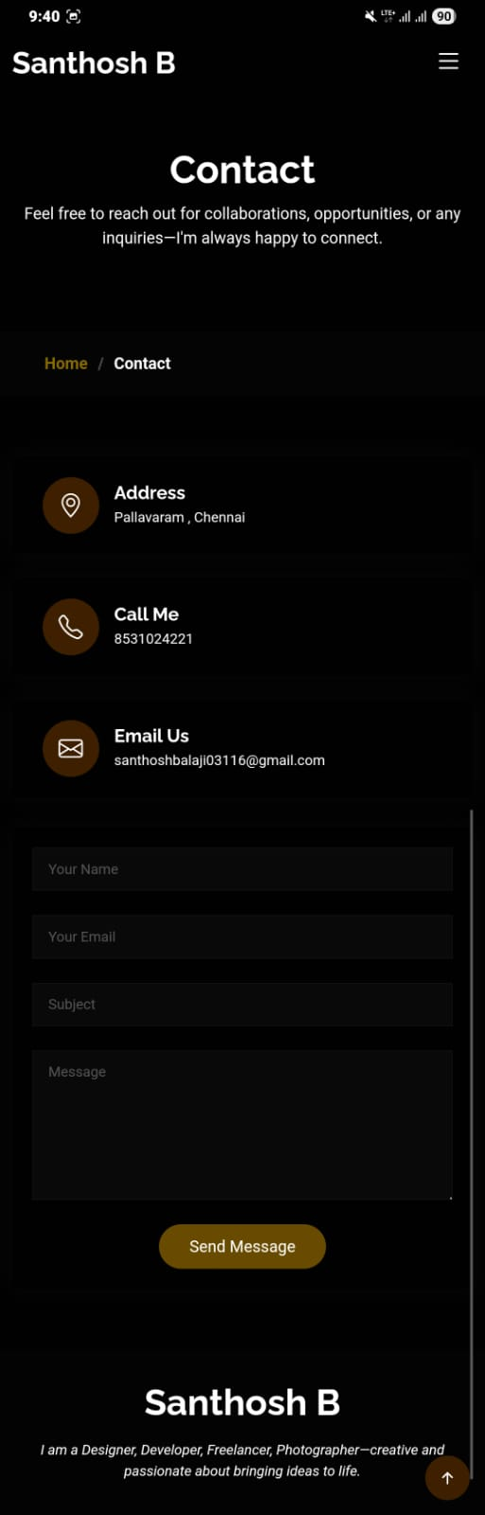

RESULTS AND SCREENSHOTS
3/21/2024 Annual Review
10

Slide 11
CONCLUSION
The portfolio website provides a professional way to showcase personal achievements and skills. It enhances career opportunities by giving recruiters a clear overview of the candidate’s profile.
11

Slide 12
GITHUB LINK
https://santhoshbalaji03116-dot.github.io/Portfolio/

